Slide 1




CS Bridge, Lecture 13 Breakout

Slide 2
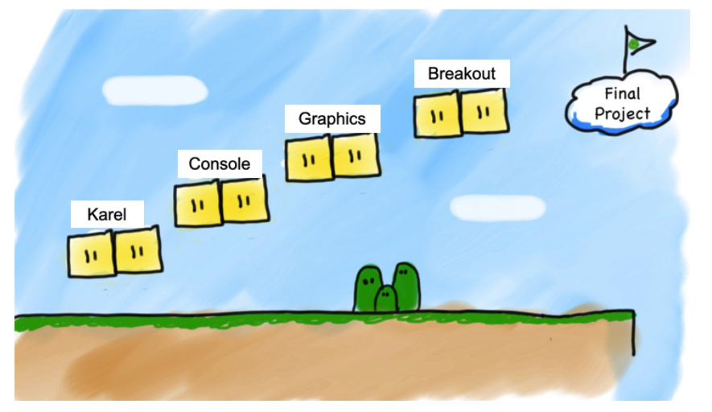

Slide 3
Breakout
Submission deadline: Friday morning

Slide 4
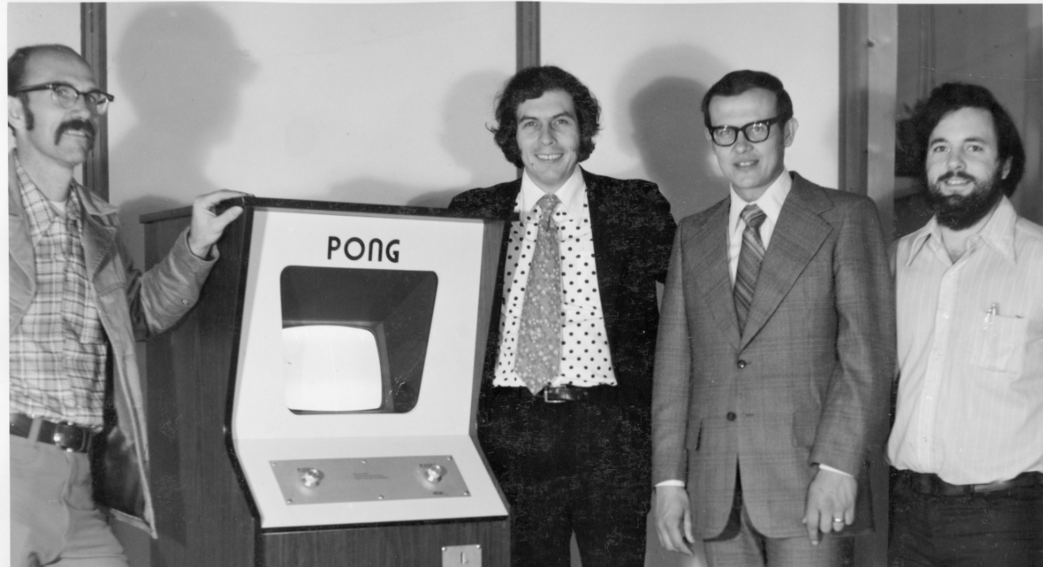
1972: Pong by Atari
1976
Designer(s)
Nolan Bushnell
Steve Bristow
Steve Wozniak
Steve Wozniak
https://en.wikipedia.org/wiki/Breakout_(video_game)
Notes:
1973 the first

Slide 5
Bushnell offered the bonus because he disliked how new Atari games required 150 to 170 chips…Jobs had little specialized knowledge of circuit board design but knew Wozniak was capable of producing designs with a small number of chips. He convinced Wozniak to work with him, promising to split the fee evenly between them….Wozniak was the engineer, and Jobs was the breadboarder and tester….The original deadline was met after Wozniak worked at Atari four nights straight, doing some additional designs while at his day job at Hewlett-Packard…. Wozniak: "we only got 700 bucks for it” Ref: Wikipedia entry

Slide 6
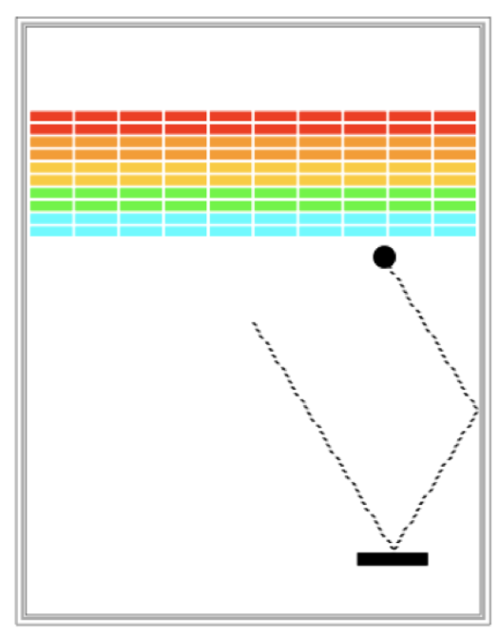
Requirements
Goal is to break all bricks
User has 3 turns
Ball in the center start moving towards bottom at random angle
Ball bounces paddle, right wall and the bricks

Slide 7
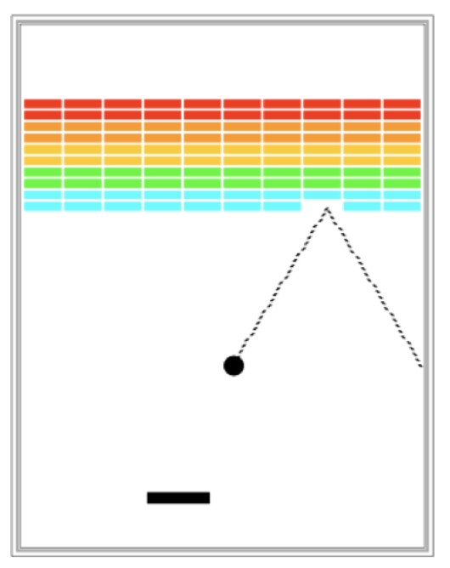
Requirements
When hit a brick, the brick disappears
Ball moves down either hitting left wall, paddle or bottom wall
The turn continues until
The ball hits the lower wall.
NEXT TURN or YOU LOOSE
The last brick is eliminated.
YOU WIN

Slide 8
Big program. Do it in parts
1
2
3

Slide 9
Some suggestions before we start
A task may include parts that look like other tasks:
Bricks in Breakout ~ Checkerboard project
Programming is not patch-work, re-think on the design
The first idea that pops-up may not be the best
This is an individual adventure:
Discuss concepts, ask questions about problems you face
Do not copy-paste someone else’s code
Think about decomposition, write clean code, add comments:
Design on paper, apply several steps of decomposition
Use meaningful function names
Add comments to your code

Slide 10
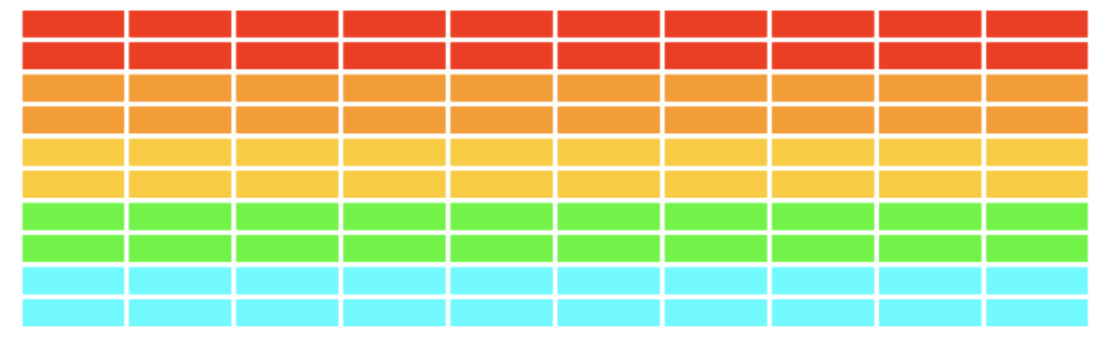
Part 1 - Creating Bricks
Number, dimensions and spacing of bricks as constants (define them at the beginning)
Calculate x coordinate of the first column - so that bricks are centered
Colors of bricks - red, orange, yellow, green and cyan
No need for lists here because we don’t plan accessing and/or modifying parameters of the objects

Slide 11
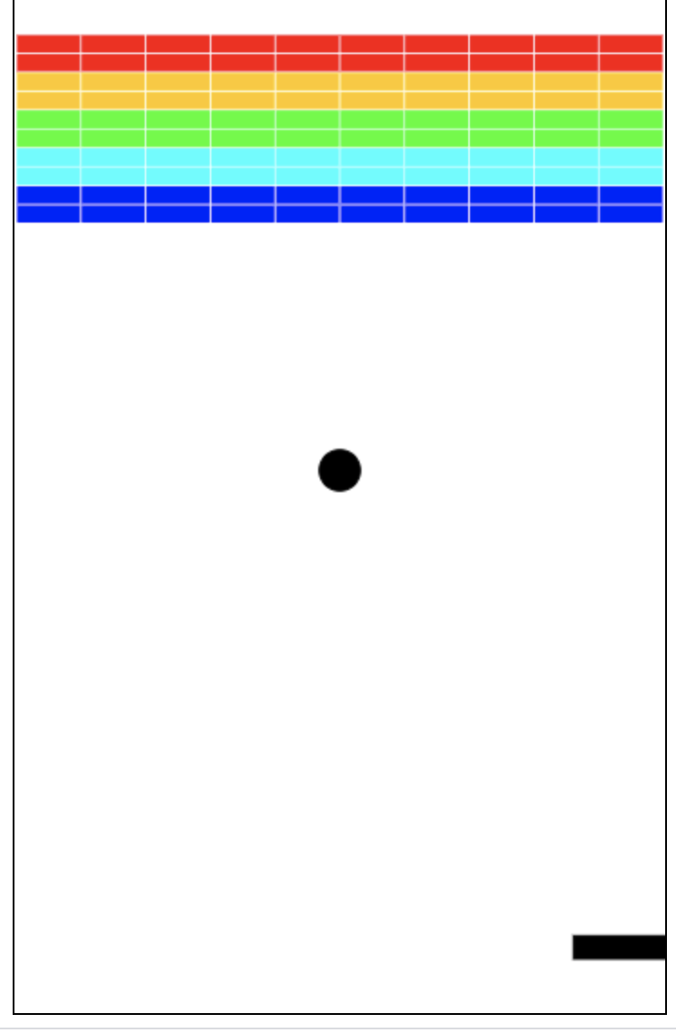
Part 2 - Add and move ball
Put filled ball at the center of the window
Velocity of the ball - declared as variables (specify a max speed (constant))
Pick random values for change in x and y
Move the ball using
canvas.move(object, change_x, charge_y)
canvas.moveto(object, new_x, new_y)
Move the ball - Initially - ball heading downwards

Slide 12
Part 2 - Bouncing ball
Animation loop - where ball is moving
Bounce from right, left and top walls
Bottom wall - start in the middle again
When bounced from top or bottom wall
Inverse change_y
When bounced from left or right wall
Inverse change_x
Update the canvas

Slide 13
Part 3 - Add Paddle
Define some constants for the dimension and location of the paddle: width, height, y-offset from bottom
Create Paddle - filled rectangle at a specific location
Link paddle move with mouse move
Move paddle - track x coordinate of the mouse only
Use mouse_x = canvas.get_mouse_x()

Slide 14
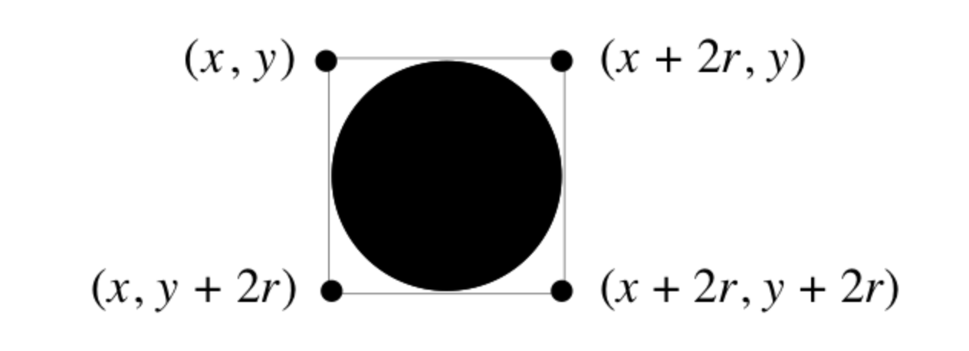
Part 4 - Check for collision
Did ball collide with another object in the window
canvas.find_overallapping (x1, y1, x2, y2) which return list of objects overalling with rectangle whose upper left is (x1, y1) and bottom right is (x2, y2)
colliding_list = canvas.find_overlapping(……..)
for loop to get a collider object in each loop:
…. do something with collider object
Think about writing a check_collision function that implements all listed above

Slide 15
Part 4 - Check for collision
Use of list
# this graphics function gets the location of the ball as a list
ball_coords = canvas.coords(ball)
# the list has four elements:
x_1 = ball_coords[0]
y_1 = ball_coords[1]
x_2 = ball_coords[2]
y_2 = ball_coords[3]
# we can then get a list of all objects in that area
colliding_list = canvas.find_overlapping(x_1, y_1, x_2, y_2)

Slide 16
Part 4 - Check for collision
Collide with a paddle
Bounce ball towards up
Collide with a brick
Bounce ball towards down
Remove brick from the screen
canvas.delete(square) # deletes the object called square
Count the number of removed bricks
That’s how you know you hit the last brick

